Slide 1
Wastewater Management in the Danube Region:
Opportunities and Challenges of UWWTD implementation
Mr. Stjepan Gabric (World Bank)
Danube Water Conference 2019

Slide 2
Implementation of UWWTD - Case of new EU countries from Danube River Basin
World Bank has a long experience of involvement in wastewater management in Danube region (from 90ties until today), and continue to support wastewater management in EU MS and candidate countries.
UWWTD is a key driver of urban wastewater sector transformation in Danube region, with large amounts of funds being committed in an unprecedented wastewater infrastructure investment cycle
The overall objective was to: (i) assess results of the UWWTD implementation in the Danube region, taking into account environmental, economic, sustainability and affordability aspects, and (ii) provide contribution to process of UWWTD review, by identifying challenges and actions that countries can take to improve wastewater management.
The specific geographic focus of this work was on new EU MS from the Danube River Basin (Bulgaria, Croatia, Czech Republic, Hungary, Romania, Slovakia, and Slovenia + Austria), that have joined EU between 2004 and 2013.

Slide 3
Implementation of UWWTD - Case of new EU countries from DRB
Where are we?
Since 2003, wastewater treatment has shown significant improvement, benefiting from largest ever level of investments in the wastewater infrastructure in the region. Still, if compared to older EU members, significant gaps in compliance with UWWTD requirements continue to exist.
Average compliance rates with Article 3, Article 4 and Article 5 in relation to the total subjected wastewater load for a) the EU28 & b) EU8 MS of DRB for the reference year 2014.
Implementation delays toward full UWWTD compliance have occurred in all five observed countries (Czech Republic, Slovakia, Hungary, Slovenia and Bulgaria) of the Danube region, where UWWTD deadlines have already expired, indicating universally unrealistic UWWTD implementation planning.

Slide 4
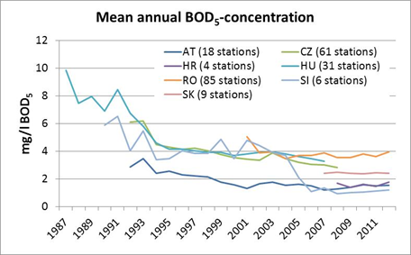
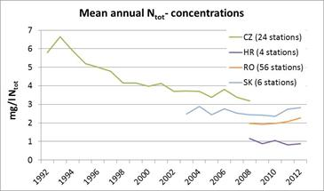
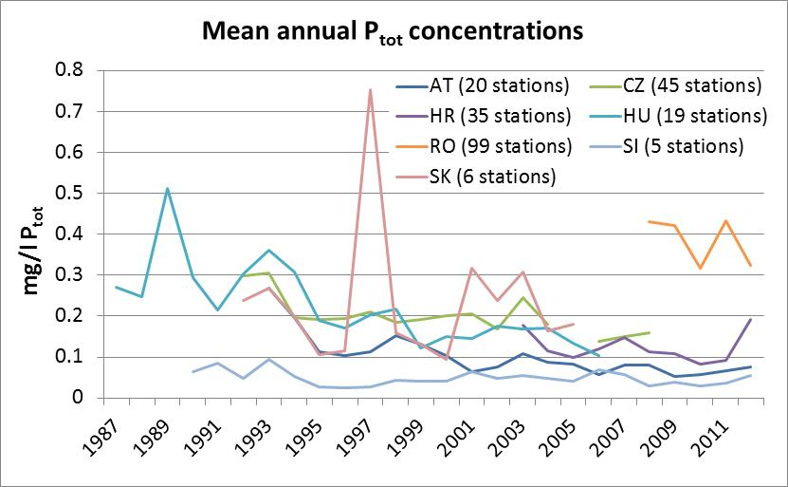
Implementation of UWWTD - Case of new EU countries from DRB
What are water quality implication?
All countries investigated have managed to decrease load emissions, corresponding to improved compliance with secondary and tertiary treatment requirements under UWWTD.
This has resulted in significant improvement of surface water quality, but more for BOD/COD than N,P.

Slide 5
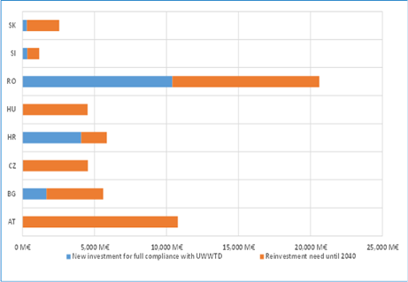
Implementation of UWWTD - Case of new EU countries from DRB
Is it financially sustainable?
Estimate of funds needed for full compliance with UWWTD for all current regional MS is around Euro 60 billion, with Euro 44 billion already invested.
Future capital expenditure demand is estimated to be about Euro 56 billion needed for continuous UWWTD compliance up to year 2040: (i) Euro 16 bill for still non-equipped agglomerations above 2,000 PE, and (ii) Euro 40 billion for reinvestment for older infrastructure needing renewal until 2040
Per capita costs of UWWTD compliance are not dependant on per capita income.
Wastewater pricing policies currently only partially support full cost recovery of water services in the eight countries, with depreciation usually only partially included in the current tariffs
Specific investment costs of UWWTD compliance , EUR/PE
Future demand for capital investment up to 2040 in countries in the Danube Region

Slide 6
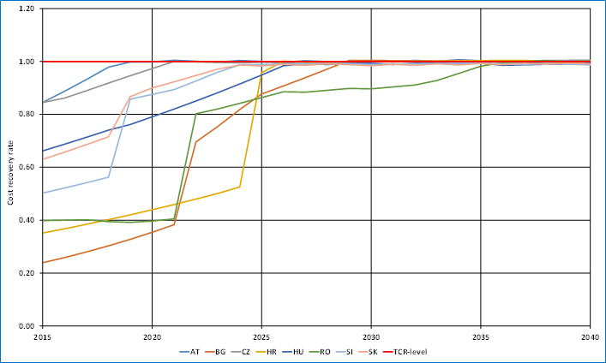
Implementation of UWWTD - Case of new EU countries from DRB
Is it financially affordable?
There is wide difference in level of tariffs in the region (average wastewater services in AT (2.0 EUR/m³) are more than three times more expensive than in BG (0.6 EUR/m³).
Robust annual tariff increases (within the boundary of EU-recommended affordability thresholds) will be required to achieve TCR ratio targeted value of 1 within a variable timeframe depending on the country.
Affordability of water services for the households is not expected to be an issue until 2040, if taking into account the highest 5% (3% for WW services) affordability threshold
Target Countries | Wastewater tariff affordability ratio [%] in 2015 | Wastewater tariff affordability ratio [%] in 2025 | Wastewater tariff affordability ratio [%] in 2040
Austria | 0.6 | 0.66 | 0.57
Bulgaria | 1.6 | 2.56 | 2.69
Czech Republic | 1.2 | 1.56 | 1.39
Croatia | 1.4 | 1.91 | 1.31
Hungary | 1.7 | 2.69 | 2.07
Romania | 3.2 | 2.99 | 3.01
Slovenia | 0.5 | 0.69 | 0.57
Slovakia | 1.4 | 2.40 | 1.91
Long-term evolution of TCR ratios in countries in the Danube region – SOP scenario

Slide 7
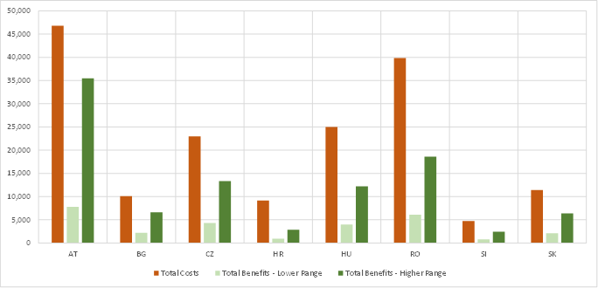
Implementation of UWWTD - Case of new EU countries from DRB
Is it economically viable?
For all countries, the overall cost of implementing UWWTD for period 2000-2040 is significantly above the higher range of the estimated benefits (which are calculated in two scenarios, lower or higher estimates)
Therefore, it can be assumed that the prevailing driver for UWWTD compliance is the need for uniformity of regulatory compliance under the EU directives, and environmental protection that goes beyond economic justification.
UWWTD related costs and benefits discounted (2015) per country in the period 2000-2040, Mio EUR
Indicators | Economic indicators at country level (2000-2040)
 | AT | BG | CZ | HR | HU | RO | SI | SK
ENPV (Lower Range) | -39,033 | -7,915 | -18,653 | -8,232 | -21,024 | -33,793 | -3,961 | -9,339
ENPV (Higher Range) | -11,357 | -3,476 | -9,672 | -6,306 | -12,801 | -21,274 | -2,307 | -5,023
EIRR (Higher Range) | 3% | 10% | 6% | * | 2% | 3% | 3% | 5%
B/C (Higher Range) | 0.76 | 0.66 | 0.58 | 0.31 | 0.49 | 0.47 | 0.52 | 0.56

Slide 8
Recommendations for better service resilience
Invest into a better process to plan wastewater management compliance and avoid underestimating the time needed for directive compliance. Building upon the experience of the new EU member states of the Danube region, candidate countries should prepare a strategic plan for wastewater infrastructure compliance well in advance of accession negotiations.
Prioritize investments according to their impact rather than on a readiness basis. Better prioritization of investments is needed to maximize the impact of available resources on UWWTD compliance and WFD objective fulfillment
Develop a financing strategy for affordable, sustainable wastewater management. Implementing the UWWTD implies substantial investment that needs to be planned well in advance and staged to facilitate and secure the mobilization of the required financial resources at the lowest costs.
Tariff increases are necessary to ensure financial sustainability, but should be accompanied with necessary WSS sector reforms to improve efficiency of service provision (governance, efficiency etc.), as a way to minimize increase

Slide 9
Recommendations for better service resilience
Service sustainability - address the question of opex financing and affordability upfront. Positive impact created by massive investments in wastewater infrastructure can be preserved and further enhanced only if service quality levels are sustained. While affordability was overall found not to be a major issues, there is a need to address existing/future affordability constraint, with targeted subsidies for poorer part of population
Technical and institutional capacity enhancement is crucial for successful wastewater project implementation. One of the main bottlenecks for UWWTD implementation has been the lack of institutional capacity of the implementing utilities, given the size and complexity of investment projects.
Conduct the reforms and policy changes necessary to implement the recommendations ahead of time. Considering the preceding recommendations, candidate countries should develop and implement the critical package of reforms needed to address the challenges and issues on technical and financial levels.

Slide 10
Implementation of UWWTD
Case of new EU countries from Danube River Basin
Deliverables:
Wastewater Management in the Danube Region: Opportunities of EU Accession” Consultant Study Report
Wastewater Management in the Danube Region: Opportunities of EU Accession” ANNEX to Consultant Study Report
Wastewater Management in the Danube Region: Is the UWWTD implementation delivering results for the people, the economy and the environment? Main Report
Publication: Danube Water Program web page (http://www.danube-water-program.org/) or World Bank web page
Thank you for your attention!

